Slide 1
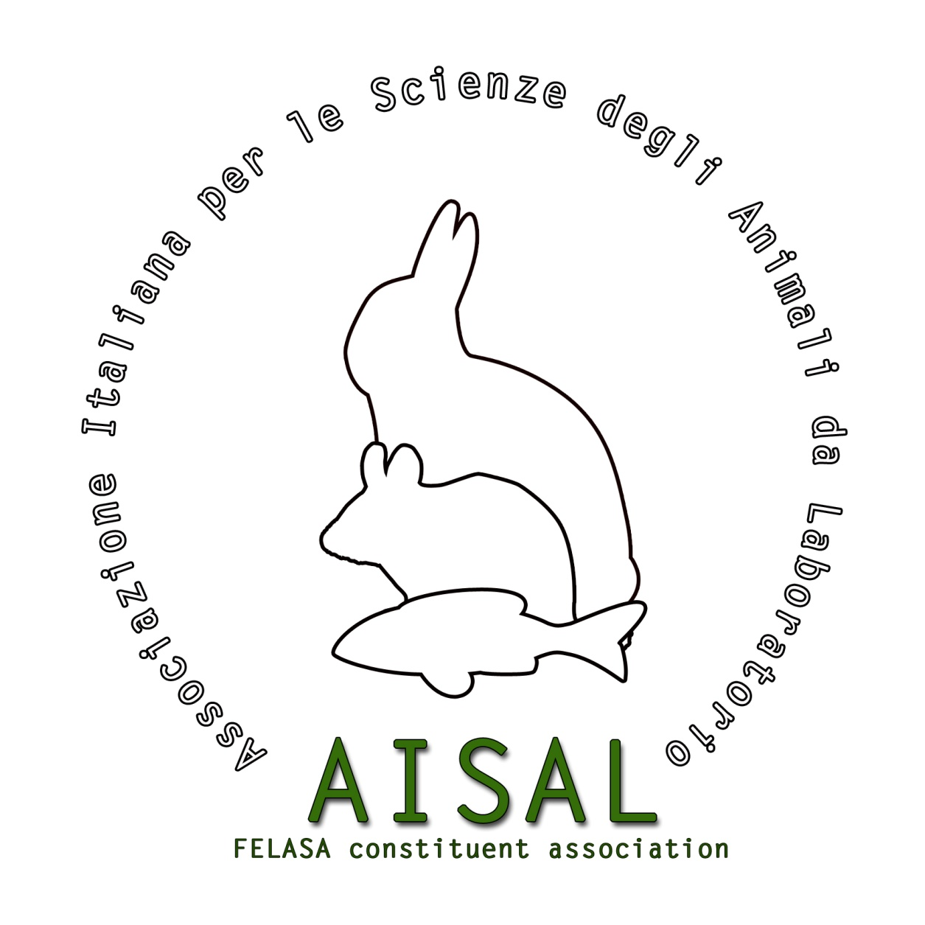
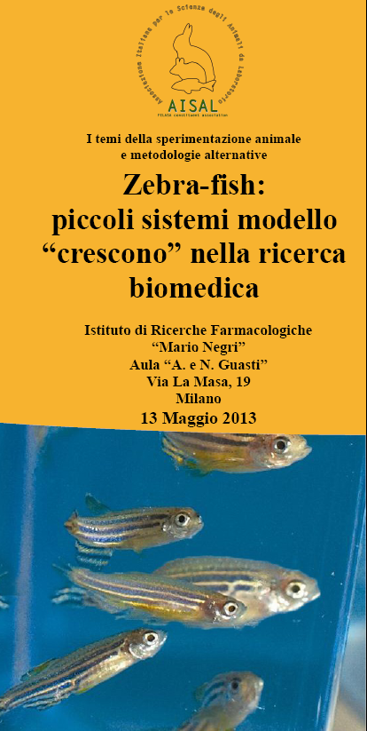
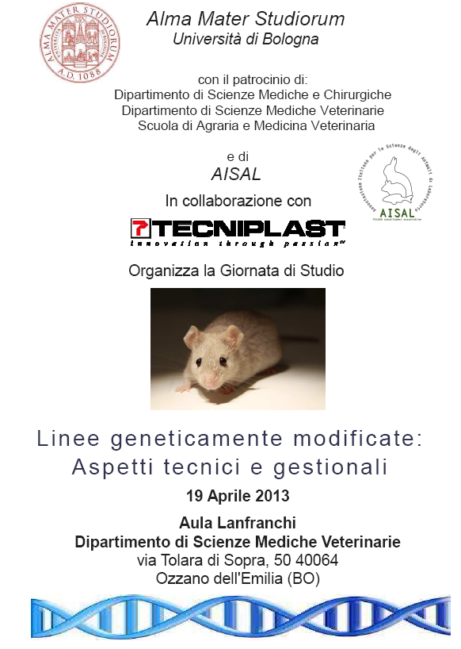
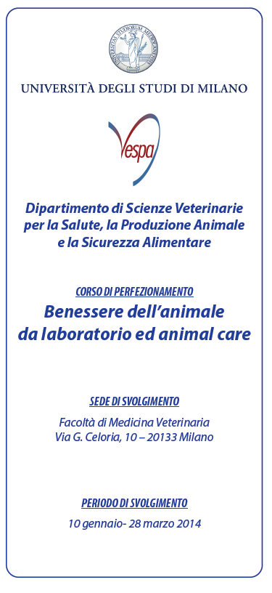
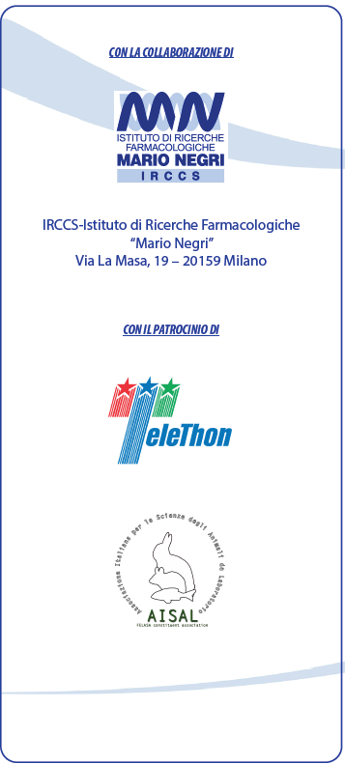
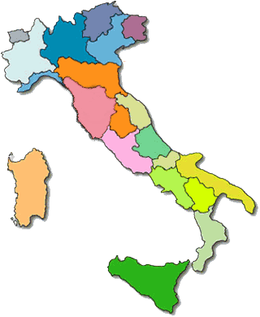
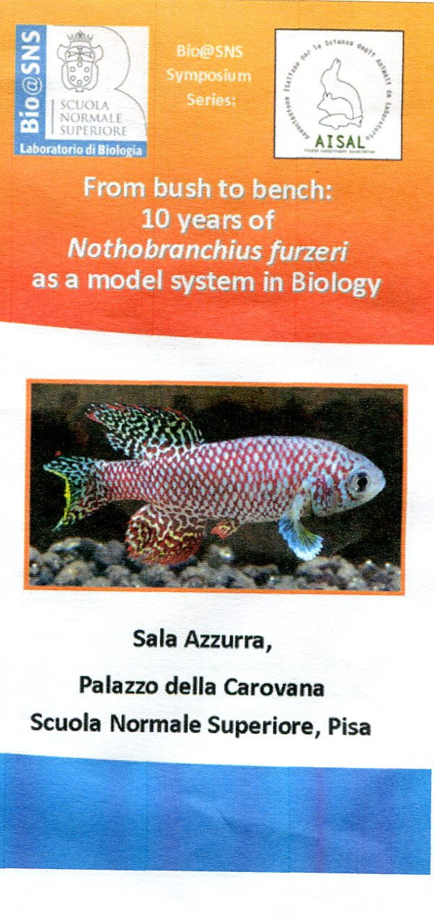
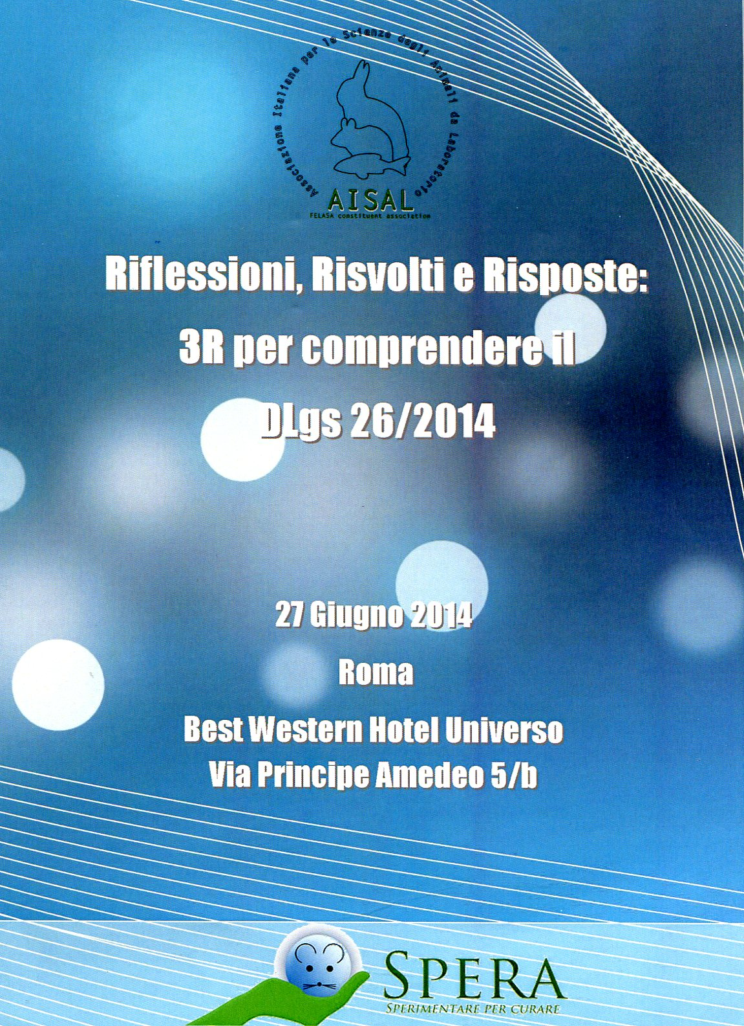
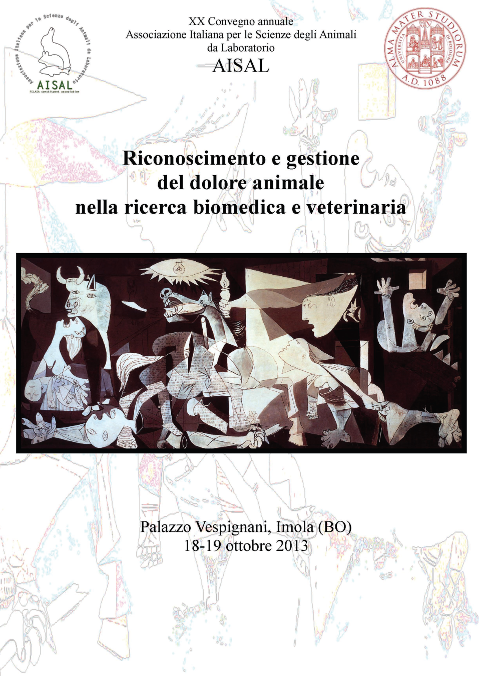
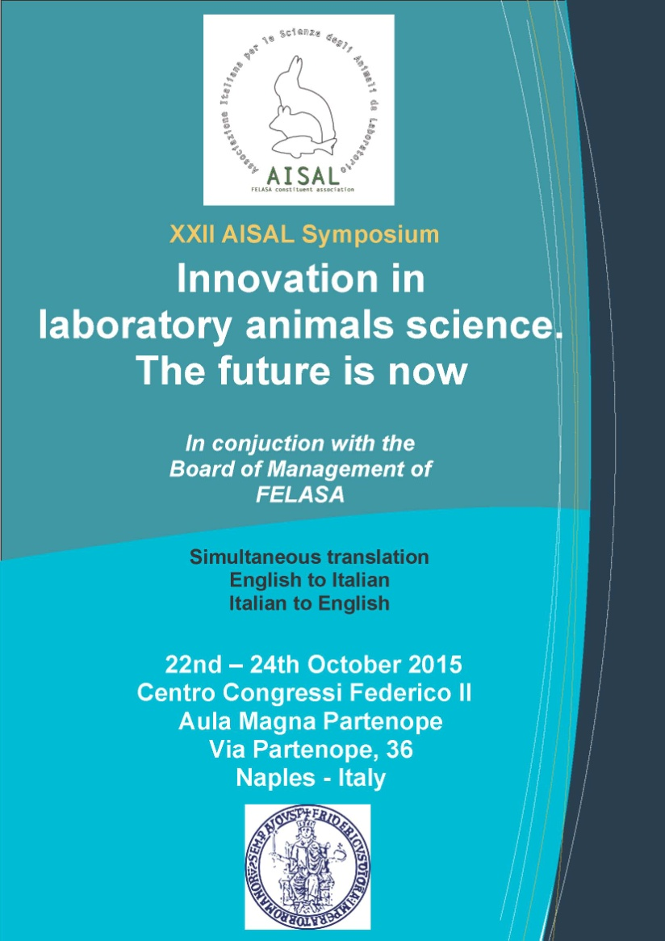
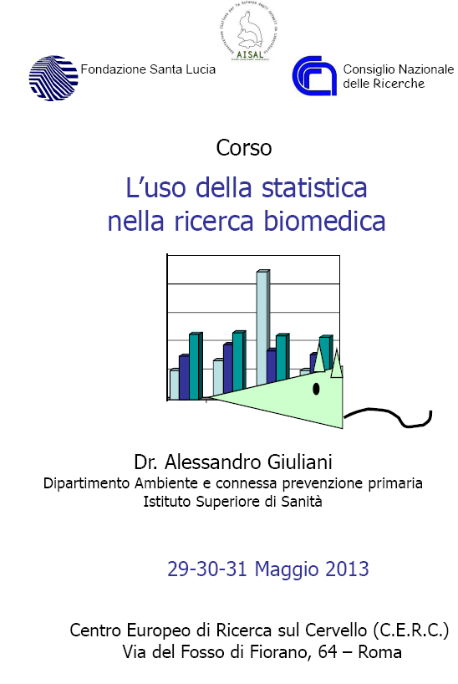
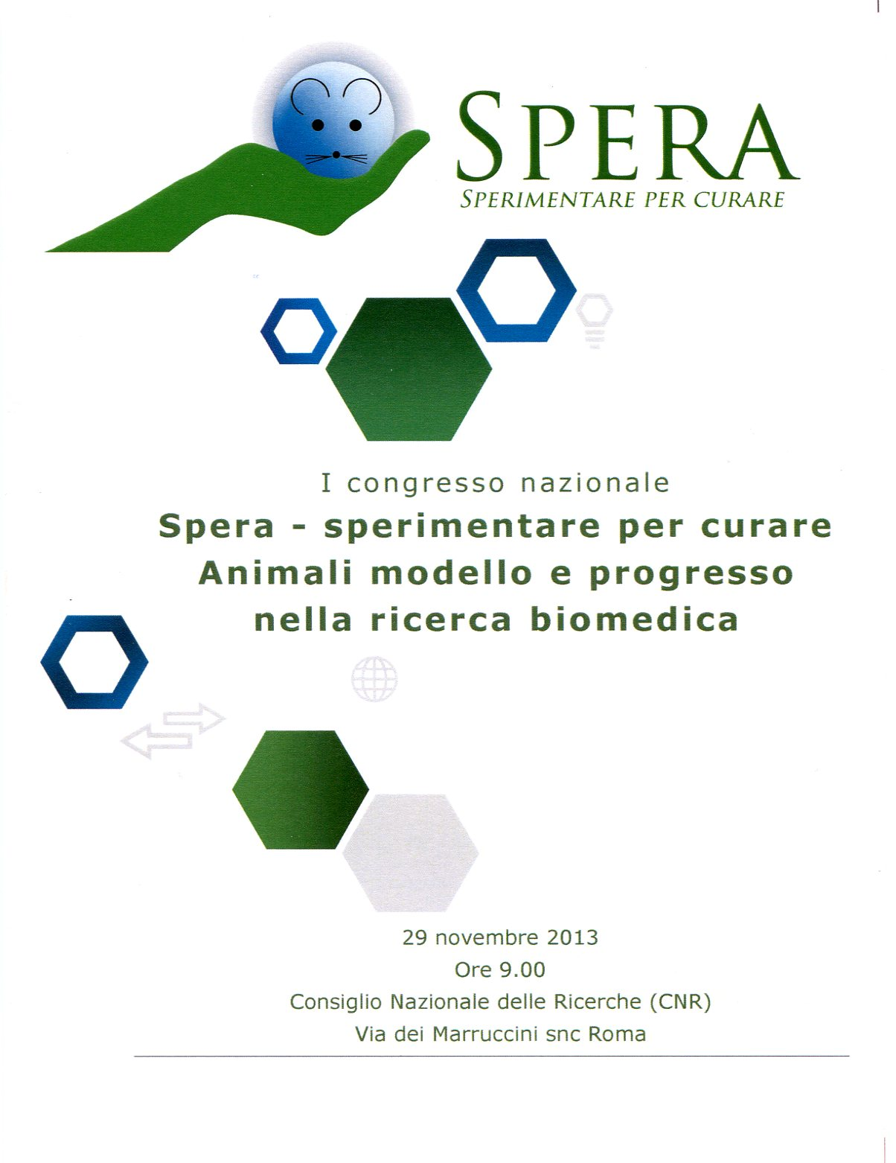
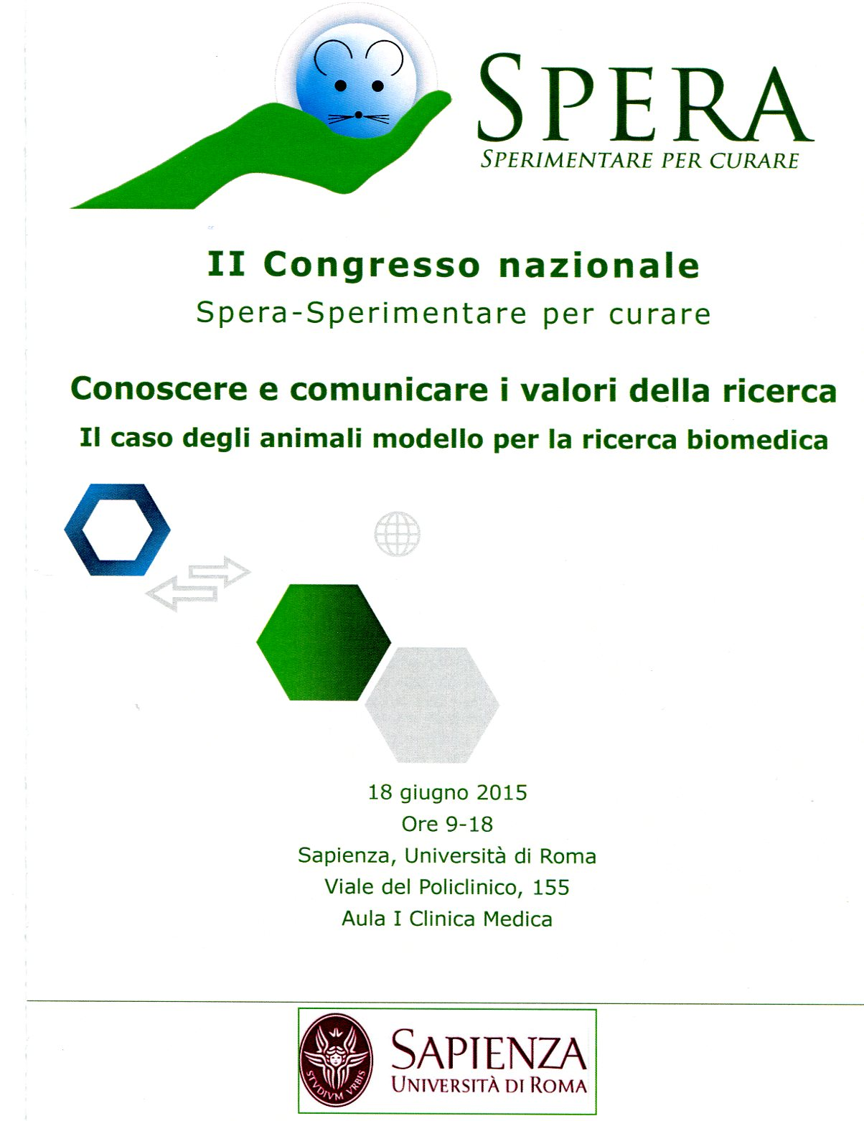
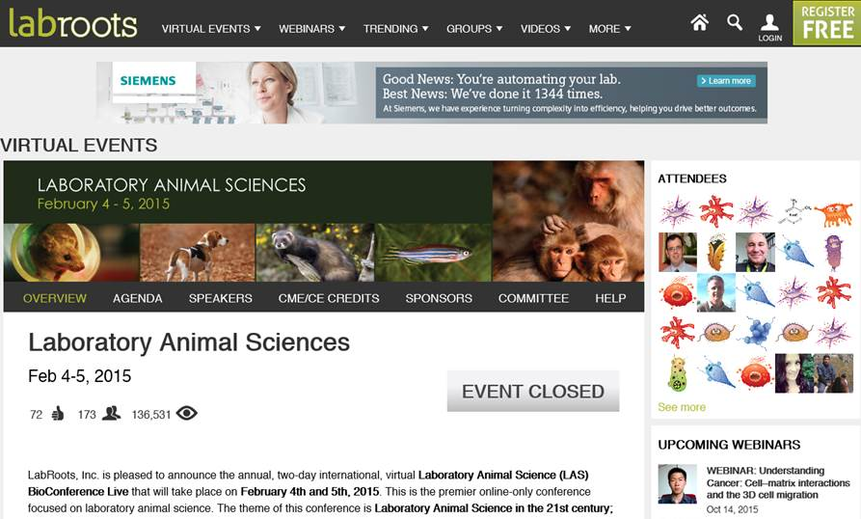
AISAL: 3 years of (in)formation & divulgation
D’Angelo Livia¹, de Girolamo Paolo¹, Fante Fabio², Piscitelli Marta³, Scarfò Marzia⁴, Vasina Valentina⁵, Wirz Annarita⁶
¹University of Naples; ²....; ³ENEA, RC Casaccia, Rome; ⁴…; ⁵University of Bologna; ⁶Santa Lucia Foundation (FSL), Rome
One of AISAL’s main objectives is to train the operators in the field of laboratory animal science through in-service training courses and workshops for technicians and researchers. They also wanted to spread information about the correct use of animals as well as to increase national and international exchanges of knowledge and experience about laboratory animal models (Art. 2 - AISAL Statute)
From November 2012 to October 2015 AISAL organized and sponsored
27 events and 3 virtual Bioconference
Events organized by AISAL
Events sponsored by AISAL
7 Training courses for researchers,
scientists and technicians
6 Workshops
5 Symposium
3 Training courses for researchers,
scientists and technicians
4 Workshops
1 Specialisation course
Geographical distribution of events
Involved Speakers/teachers:
234
of whom
211 Italians
23 Foreigners
13 in the North
10 in the Center
4 in the South
People (in)formed:
2306
plus all the people who partecipated in the virtual bioconference
6 Courses
“The use of statistics in biomedical research”
3 Laboratory Animal Science
Bioconference
with a virtual stand
The goal of this biannual course is to respond to the researchers' need to have (in)formation on some statistical aspects useful when working with animals, as the appropriate use of statistics allows a reduction of animals.
Special thanks to Mary Raule
for her great support

